Slide 1

Exploratory Data Analysis and Modelling Proposal
Persistency of a Drug
Team: Quantic
Members: Ansel Vallejo
Date: November 16th , 2023

Slide 2
Agenda
Business Problem
Approach
EDA
EDA Recap
Recommendations

Slide 3
Business Problem
ABC Pharma Company, in its relentless pursuit of pharmaceutical excellence, grappled with a persistent challenge: understanding the duration of drug persistence aligned with physician prescriptions. To surmount this obstacle, ABC Pharma astutely partnered with Quantic, a trailblazer in streamlining and automating processes. Through the strategic application of data analytics, the pharmaceutical titan aimed to unravel intricate drug persistency patterns, empowering informed decision-making and ushering in a new era of superior patient care. This synergistic collaboration between ABC Pharma and Quantic underscores a steadfast commitment to harnessing the power of data-driven solutions, effectively tackling pivotal industry challenges head-on. The ultimate objective remains crystal clear: to accurately predict patient adherence to physician-prescribed treatments, ensuring uninterrupted medication adherence throughout the course of therapy.

Slide 4
Approach
The dataset presented contains 3,424 datapoints and 69 variables.
For better understanding, the data is grouped in buckets:
Demographics
Provider Attributes
Clinical Factors
Disease and Treatment Factors
The exploratory data analysis (EDA) was conducted using a similar framework, encompassing the entirety of the dataset, thereby extracting potential insights from the comprehensive analysis.
Two model proposals have been formulated.

Slide 5
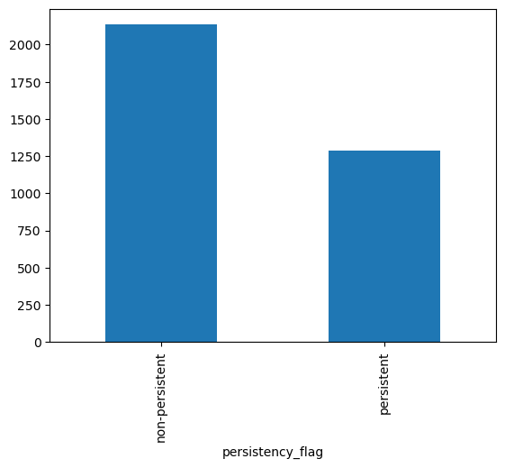
Persistent vs Non-Persistent
non-persistent 2135
persistent 1289

Slide 6
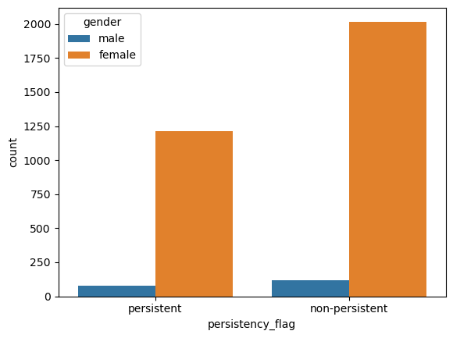
Gender
What gender is most persistent of taking the drug?
Males have the lowest sample size of persistent and non-persistent of a drug totaling 194, whereas Females have the highest sample size totaling 3230.
Males tend to have higher persistency than Females by 2.17%, whereas Females have higher non-persistency than Males by 2.17%.

Slide 7
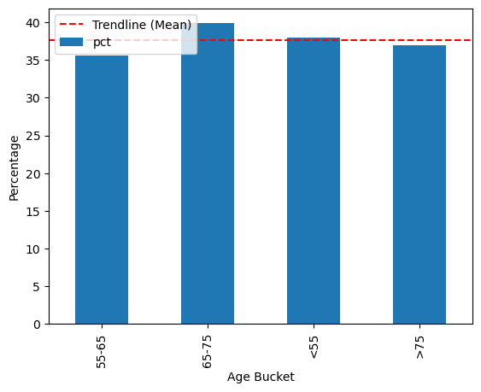
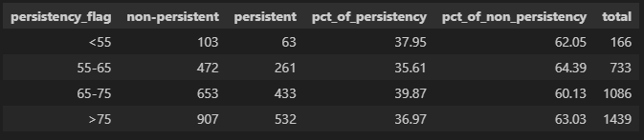
Age
Is age a big contribution to drug persistency?
Age group of 65-75 has the highest percentage of drug persistency at 39.87% out of the others, exceeding the mean persistency by 2.27% from all age groups.

Slide 8
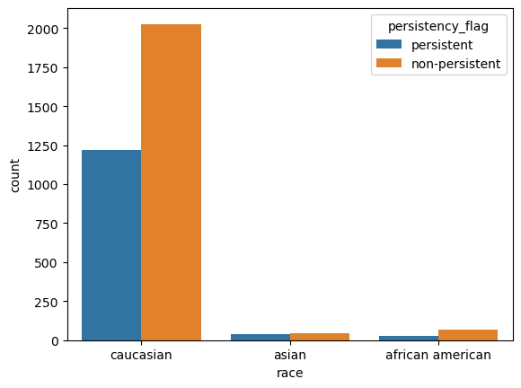
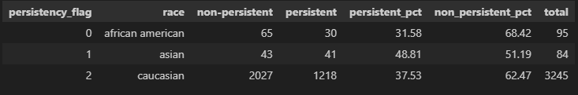
Race
What is the percentage of persistency based on race?
Therefore, based on the calculated differences, African Americans exhibit the most substantial contrast in drug persistency percentages between persistent and non-persistent cases among the provided racial groups.

Slide 9
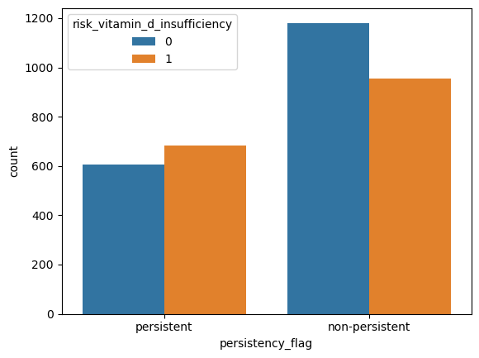
Risk Factor
Risk of Vitamin D Insufficiency
There is an interesting relationship between persistency and the risk of Vitamin D insufficiency.
If the patient is persistent, the chances of Vitamin D insufficiency is greater than non-persistent patients.

Slide 10
EDA Recap
The dataset comprises details of 3,424 patients, encompassing demographic data, clinical records, information on other diseases as risk factors, and details about their physicians' specialties.
Age and Gender play a key role to help further explain the disparities between the categories in terms of persistency.
Distinct differences emerge between individuals of Asian descent and other racial groups within the dataset, suggesting noteworthy disparities in various aspects.
Notable variations are evident across patients concerning factors like vitamin D deficiencies.

Slide 11
Model proposals (technical review)
Logistic Regression Model:
Advantages:
Straightforward binary classification.
Provides probability estimates.
Suitability:
Ideal for handling binary outcomes and offering insights into class probabilities.
Decision Tree Model:
Advantages:
Offers interpretability with visual decision pathways.
Accommodates diverse data types effectively.
Suitability:
Useful for transparent decision-making processes and handling both categorical and numerical data.

Slide 12
Thanks! ☺

